Slide 1
Dual Enrollment @Mesa
Linda Hensley
Dean, Humanities & CCAP

Slide 2
Type of Dual Enrollment
CCAP – California College and Career Access Pathways
Goal: Develop pathways from high school to college for underrepresented student populations
ACP – Accelerated College Pathways
Opportunity for high achieving high school students to complete college courses
Individual Dual Enrollment
High school students work with their high school counselors and our admissions office

Slide 3
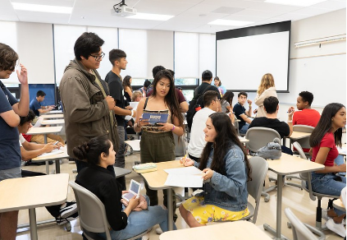
Overview of CCAP
Partnership between High Schools and Mesa
Target Students
Dual Enrollment

Slide 4
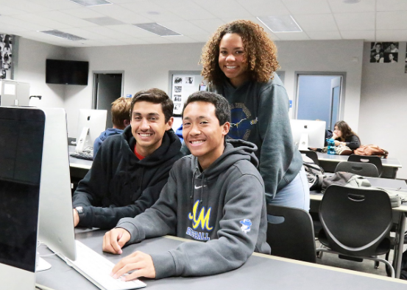
Partner High Schools
SDUSD
Clairemont * Hoover * La Jolla
Madison * Mission Bay * Morse
Mt. Everest * Patrick Henry * Point Loma
SD Met * University City
High Tech High
Mesa * Point Loma

Slide 5
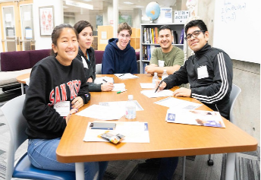
Regional Strong Workforce Program Dual Enrollment Funding Opportunity
Expand opportunities for students to earn up to 12 units and participate as early as 9th grade
Providing more equitable dual enrollment programming
Expanding dual enrollment in CTE/CE courses
Expanding populations served to include students under-represented in higher education
Enhancing regional Colleges’ abilities to track and use data for informed decision making

Slide 6
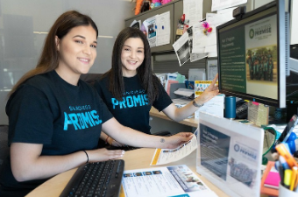
Dual Enrollment Project
Phase I (Year 1) & Phase II (Years 2-4)
Phase I: Create a Strategic Plan

Slide 7
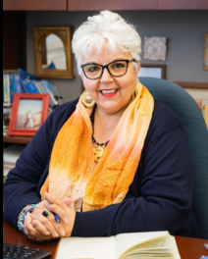
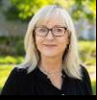
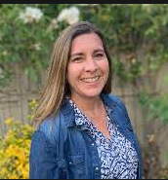
Dual Enrollment Team
Isabel O’Connor, VP Instruction
Gina Abbiate, CCAP Faculty Coordinator
Alex Berry, Associate Dean, CTE
Laura Mathis, Counselor Rep
Jennifer Park, Outreach
Jill Moreno-Ikari, Asst. Chair, English
Karina Sandoval, Supervisor, Admissions
2 reps – Unified & HTH
Linda Hensley, Dean, Humanities & CCAP
Hai Hoang, Dean, Institutional Effectiveness

Slide 8
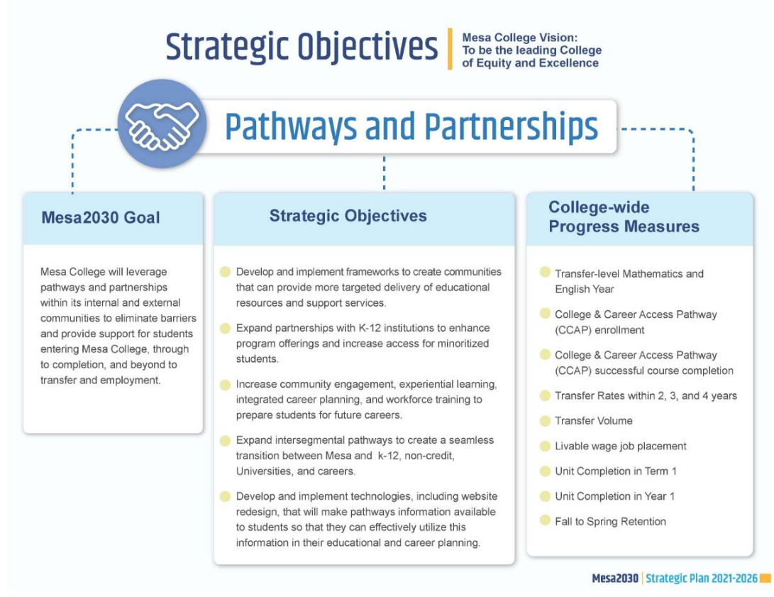
Dual Enrollment Strategic Plan Informed By:
SDCCD Strategic Plan
Mesa 2030
Equity Plan
Guided Pathways
Enrollment Management Plan

Slide 9
Thank you for listening!
Any Questions?

