Slide 1
Quick Updates
From General counseling
02/14/2024
Presented by Dr. Cynthia Rico, Counseling Department Chair

Slide 2
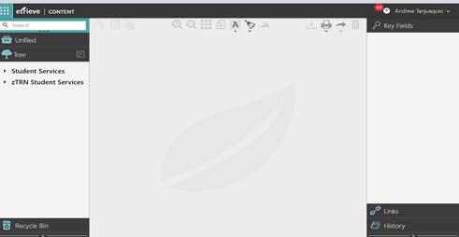
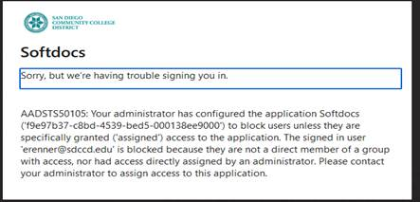
Etrieve | Content
https://sdccdcontent.etrieve.cloud/#

Slide 3
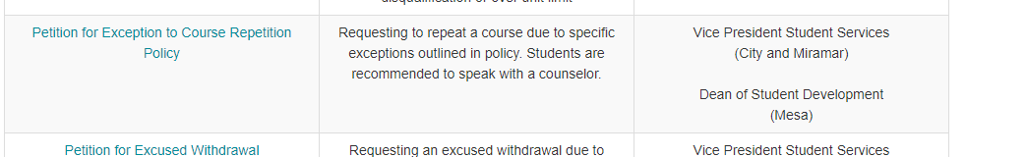
Jira Update: Petition for Exception….
https://www.sdccd.edu/students/forms-and-documents.aspx

Slide 4
SDCCD Counselors Conference,
March 1, 2024 G-Building 8:00 to 1:00
Friday, March 1, 2024, Mesa College, will be hosting the District Counselors Conference from 8:00 to 1:00 p.m. in the G-building. We are looking forward to seeing all of you in this space and learning more about what is on the horizon regarding student services, curriculum and about the great work our fellow colleagues are doing at their respective colleges.
PLEASE RSVP, as we need to receive a solid confirmation of who is attending to ensure there is enough food for the day.
DEADLINE To RSVP is Monday 2/26/2024.
EVENTBRITE LINK TO RSVP:https://www.eventbrite.com/e/827510003697?aff=oddtdtcreator

Slide 5
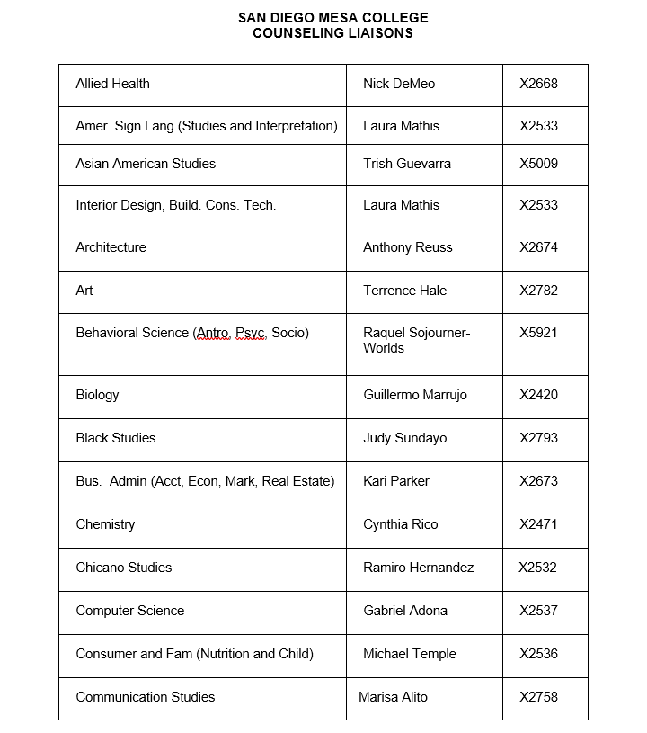
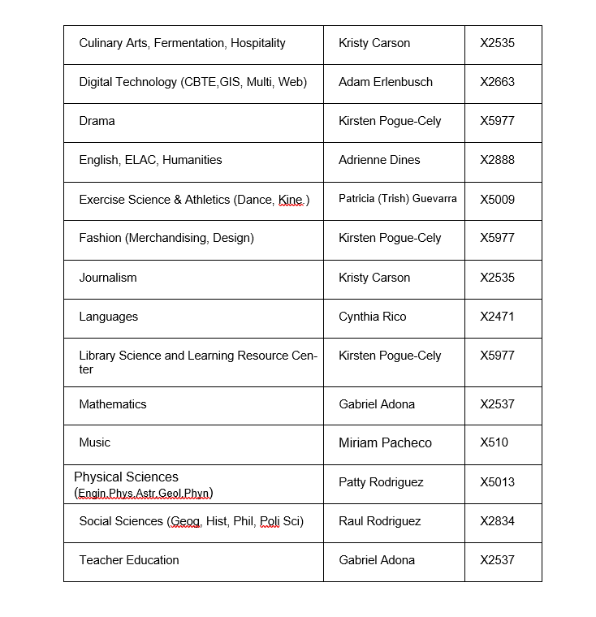
Counseling Department Liaisons and Beyond

Slide 6
