Slide 1



20
25
Mesa
Launchpad
-Presenter: Karla Trutna

Slide 2


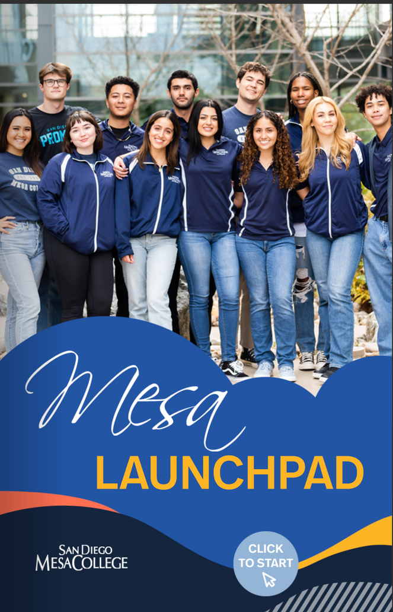

NEED FOR
Mesa Viewbook
1.) Outreach needed a marketing piece that could highlight Mesa’s amazing Career Education (CE) programs.
2.) This marketing piece would be shared with all of our prospective students (including international students), families, and community members.
3.) We wanted to present Mesa’s career exploration tool.

Slide 3


1ST STEP
PROPOSAL
Mesa Pathways: Onboarding and Career Exploration (OCE)
1.) A funding proposal was submitted to Regional CTE Pathway Navigation (May 2021) and it was approved.
2.) Claudia Estrada Howell, Shawn Fawcett, and Alex Berry approved.

Slide 4




TEAM
Shawn Fawcett, Rachel Russell, Jennifer Kearns, Monica Romero, Star Mohammadi (student PA), Jocelyn De Santiago-Ramirez (Mesa Student/Alumni), and Karla Trutna.

Slide 5

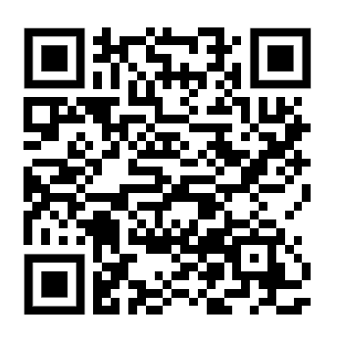
FINAL
PRODUCT
As part of our larger Career Education outreach and marketing efforts we have developed the Mesa Launchpad, a prospective student career exploration tool.
LINK: https://indd.adobe.com/view/7fd54417-f0b8-416d-bc4f-ad7077463ff7

Slide 6


HOW
How did we do this great work?
Our team generated specific content on the career page using Mesa’s Website and O*Net to show students:
• The general overview and the paths at Mesa that can lead to the career
• Who would succeed in this career (characteristics, personality, skills)
• What you do in this job
• Where you can do this career
After all that!
Faculty, Chairs and Deans insight and expertise was requested to review content.
LAUNCHPAD -
4 OBJECTIVES
  Helping students “Find Their Why” at Mesa
  Introduce students to career exploration tools and supports at Mesa
  Highlight 10 careers that can be “launched” from various programs and degrees at Mesa
  Get students to apply to Mesa.

Slide 7
What Programs were selected?
What’s Next??
Academic Programs that were selected (Will change every year) -
Entrepreneur| Choreographer | Dental Assistant| American Sign Language Interpreter | Brewer | Curator | Data Scientist | Preschool Teacher | Oceanographer | Construction Management
Next Steps –
1.) Promote campus wide.
2.) Translate to Spanish – Thank you to Olivia Picolla, Celine Ahearn, Darcey Flores, and Jose Ortega.
3.) Outreach will be able to share this with all students and their families!
4.) Communications Team will add the link to the Mesa Website.

Slide 8

Thank you!
Questions?

