Slide 1

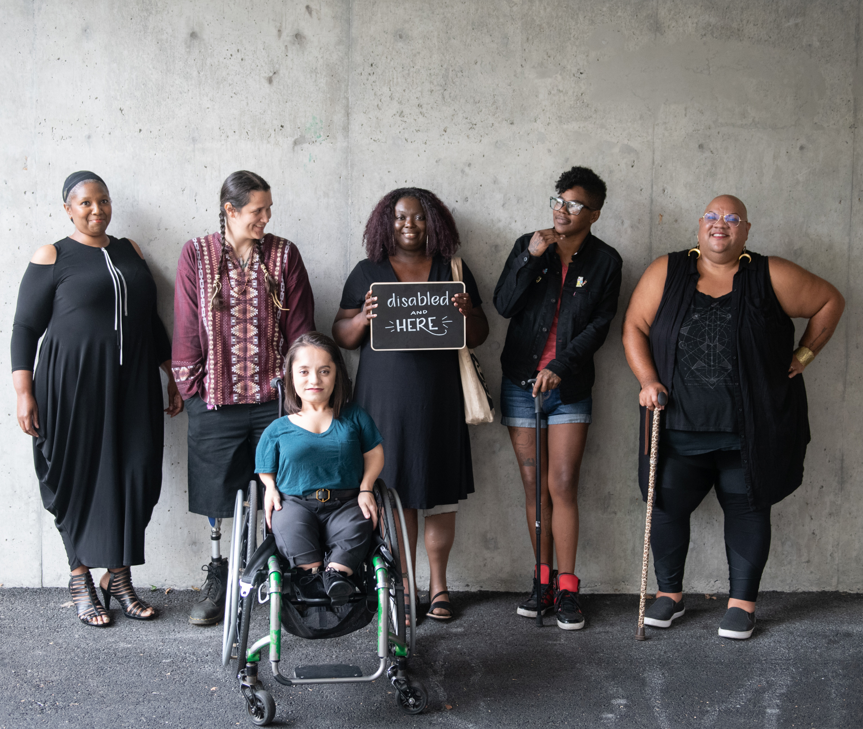


Disability Aware at SDCCD
Sneak Peak!
Background Story: Cross District Collaboration with Student Involvement
Training developed with generous support by DSPS and Perkins Reserve Innovation Grant funding.
Notes:
Welcome!
Don't forget to take the pre-training survey if you haven't already
Tech: Drop pre/post training survey in chat: https://tinyurl.com/DisabilityAwareSurvey
Image: Six disabled people of color smile and pose in front of a concrete wall. Five people stand in the back, with the Black woman in the center holding up a chalkboard sign reading "disabled and here." A South Asian person in a wheelchair sits in front. Credit: Disabled and Here project, taken by Chona Kasinger

Slide 2

What to Expect Today
Sneak Peak inside the Disability Aware Training
Background & Overview of the Project
Overview of What's Included in Full Training
Myth and Facts
Selected Slides & Videos from Training
Opportunity to Invite DSPS to Your Department for the Full Training:)
Notes:
Here’s what to expect as we move through the training.
There are Myth or Facts pop quizzes throughout the training.
Part 1 Disability Facts & Activism, Why Disability Aware?, Disability Glossary
BREAK about 10 minutes
Part 2 Spoon Theory, Reducing Barriers
Closing DSPS Student Perspectives, Contact, Resources, Q&A

Slide 3
A Overview of the Full Training Format (1.5-3 Hours)
Myth and Facts
Included throughout
Part 1 Disability Facts & Activism, Why Disability Aware?, Disability Glossary
BREAK
Part 2 Spoon Theory, Reducing Barriers, Role Play
Closing DSPS Student Perspectives, Contact, Resources, Q&A
Disability Aware Swag & Badge
Notes:
Here’s what to expect as we move through the training.
There are Myth or Facts pop quizzes throughout the training.
Part 1 Disability Facts & Activism, Why Disability Aware?, Disability Glossary
BREAK about 10 minutes
Part 2 Spoon Theory, Reducing Barriers
Closing DSPS Student Perspectives, Contact, Resources, Q&A

Slide 4

Disability Defined
“An interaction between an individual’s personal condition (such as [using] a wheelchair or having a visual impairment) and environmental factors (such as negative attitudes or inaccessible buildings) which together lead to disability and affect an individual’s participation in society.” (United Nations)
Disabilities can be visible/apparent or invisible/hidden.
People may choose to disclose or not disclose.
Disabilities can be congenital or acquired.
Language around disability is evolving and nuanced.
Notes:
Disability Defined
There are many legal and medical definitions of disability, but here is one from the UN that gets to the heart of our training today. Important: It is not solely the person’s impairment, but also the person’s environment which creates a disabling experience.
Visible/Apparent or Hidden/Non-Apparent: We’ll talk about the importance of awareness around hidden or non-apparent disabilities and how it applies to faculty and staff in an educational setting.
Congenital or Acquired – important for folks to consider that even if you don’t have a disability now, many people acquire disabilities over time and with age.
Evolving language – We will explore terminology more thoroughly in our Disability Glossary section, but we want to note that you will hear phrases such as “Disabled students” (which is an example of Identity-first language) and “Students with disabilities” (which is an example of Person-first language). We will cover what this means in detail and best practices for each type of language as we move forward in the training.

Slide 5
DSPS Defined
Through inclusive, accessible, and equity-driven programs, Disability Support Programs and Services (DSPS) fosters high-quality learning opportunities for students. We support the social, educational, and career journeys of students with disabilities by meeting them where they are, building on their strengths, and by supporting the districtwide community to increase goal achievement for and with people with disabilities.
Notes:
Just in case you’re not sure what DSPS is, or what it even stands for…[definition]
DSPS is responsible for District compliance with all laws related to disability in higher education.

Slide 6
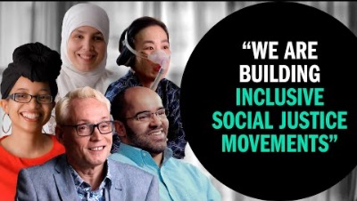
Disability is Diversity
Source: Youtube @fordfoundation
Notes:
First, we want to emphasize that awareness and mindful action around disability rights and all other intersecting social justice work is crucial for a disabled population that has so often been excluded from so many conversations around civil rights, diversity, and inclusivity.
Tech: Play full video (backup link: https://www.youtube.com/watch?v=PKydT17O6LM)
After video: Group discussion for a few minutes…what comes up watching this video? Why is it important to align disability awareness and inclusion within greater contexts of social justice and diversity?

Slide 7
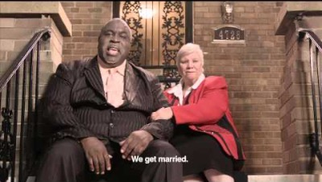
Feeling Awkward? That’s okay!
Source: Youtube @dcgovernment
Source: Youtube @dcgovernment
Notes:
Here’s a quick video to acknowledge how learning (especially in a professional setting around topics we might not know much about) can sometimes feel awkward and uncomfortable
Tech: Play full video (backup link: https://www.youtube.com/watch?v=Gv1aDEFlXq8)
After video: It’s okay to be uncomfortable or feel awkward in this space. We’re here to learn and grow together and move forward into a place of confidence so we can better support all our students and colleagues.

Slide 8
Myth or Fact
Myth or Fact: The disabled community is the largest and most diverse historically marginalized population.
Fact: 1 in 4 adults in the U.S. has some type of disability, and the disabled community is the largest and most diverse historically marginalized population (CDC). Disabilities are more common and diverse than some may believe.
Notes:
Let's delve into another important aspect of disability awareness: the size and diversity of the disabled community.
Myth or Fact: The disabled community is the largest and most diverse historically marginalized population.
Fact: 1 in 4 adults in the U.S. has some type of disability, and the disabled community is the largest and most diverse historically marginalized population (CDC). Disabilities are more common and diverse than some may believe.
Now that we have a clearer understanding of the diversity within the disabled community, let's shift our focus back to DSPS, ensuring everyone is on the same page about its role and importance.

Slide 9
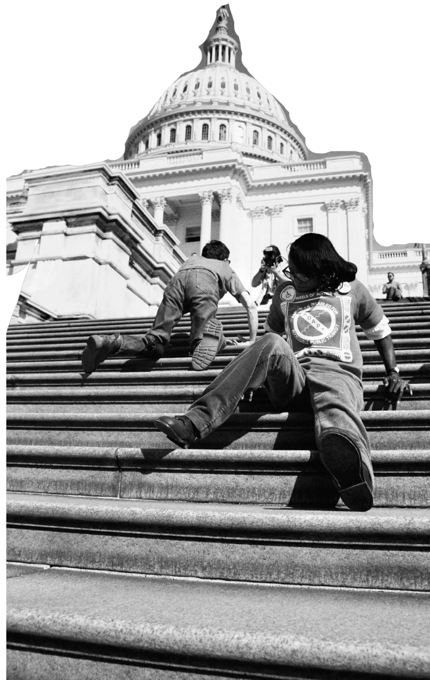
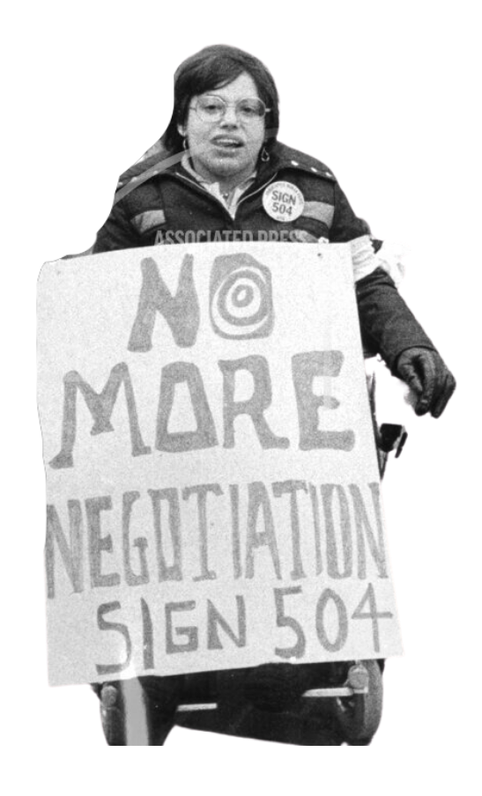
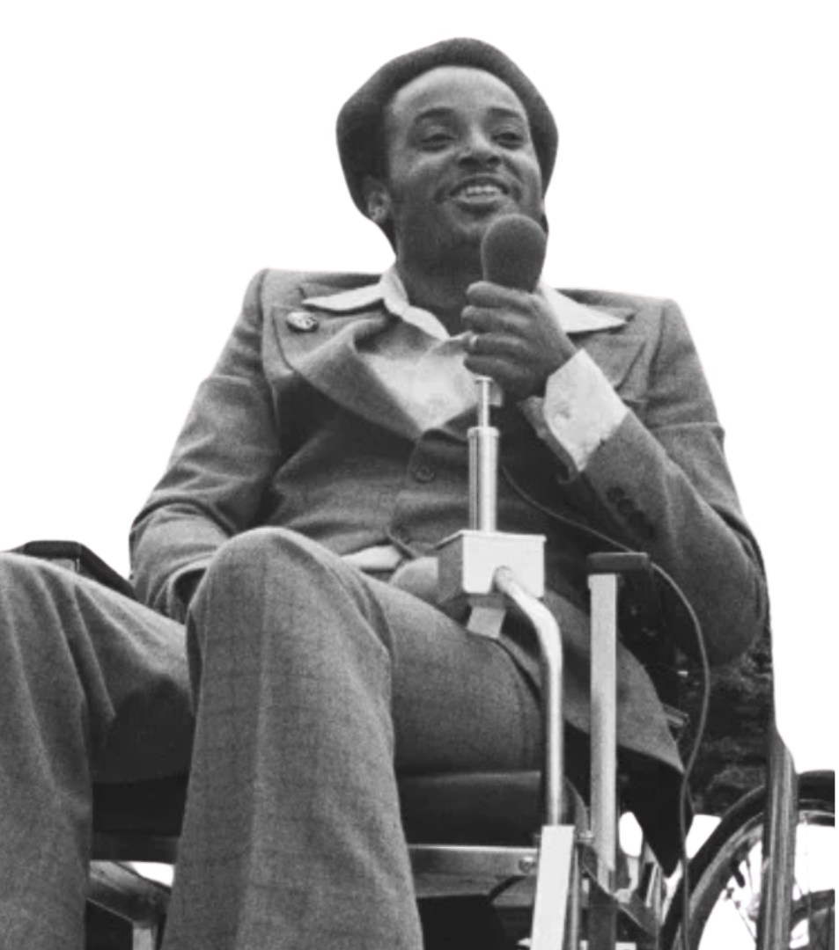
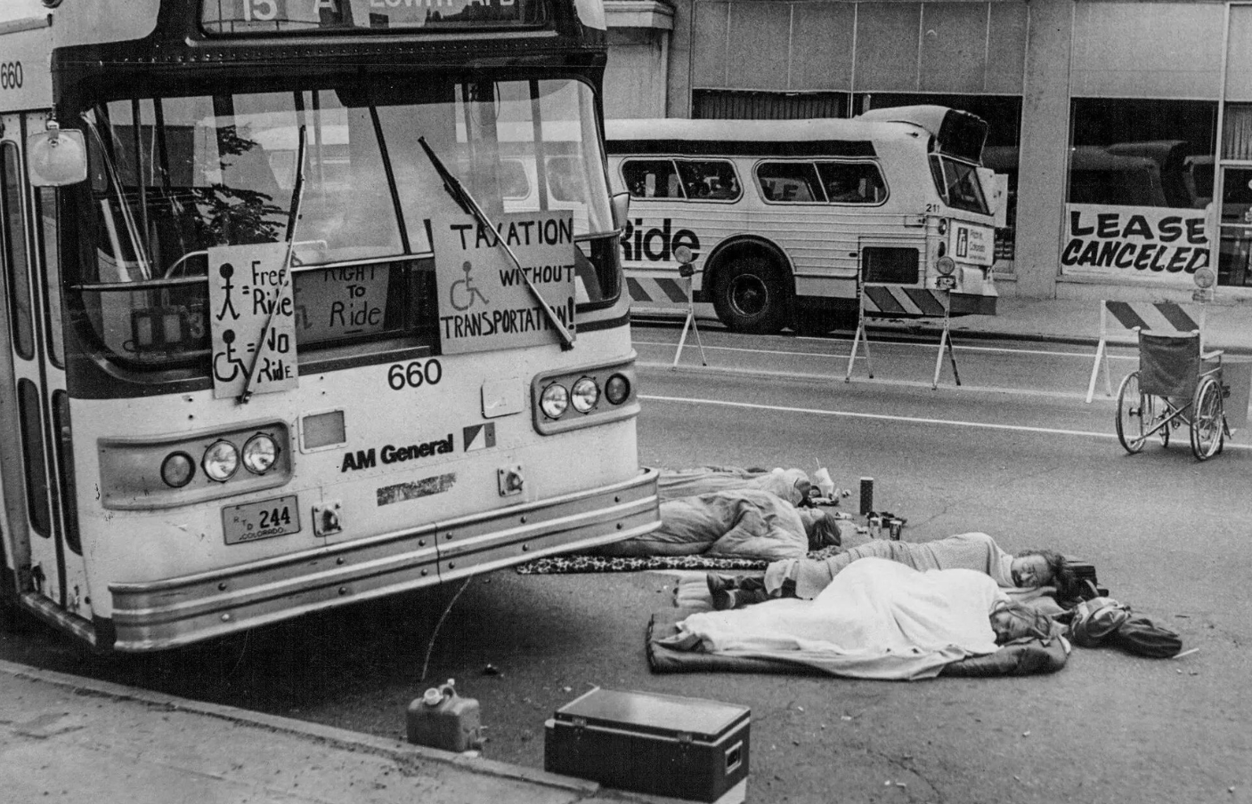
Disability Facts & Activism
Notes:
Whether this section is brand new information to you or more of a refresher, it’s important to start with some general context about what disability is, about what DSPS does, and about the rich history of disability rights activism throughout U.S. history - much of which has been led by student activists.
Collage of pictures from various historical events in disability rights activism
PICTURE 1 Demonstrators in Denver protesting the lack of wheelchair lifts on city buses in 1978
PICTURE 2 Judith Heumann, advocate for disability rights and an official at Center for Independent Living advocating for the enforcement of Section 504 legislation 1977
PICTURE 3 Brad Lomax at a Washington DC rally in 1977
PICTURE 4 Protesters hoisting themselves up the steps of the United States Capitol – 1990
After this training, we will follow up with a resource guide that includes a more thorough overview of the disability community and disability rights activism, but here are a few key pieces that are foundational to this training and our work in higher education

Slide 10
Major Milestones
Section 504 of the Rehabilitation Act (1973)
Prohibits recipients of federal aid from discriminating against anyone with a disability.
In intersectional partnership with social justice orgs like The Black Panthers, disability rights advocates successfully demonstrated/occupied government buildings to demand enforcement of the law.
Americans with Disabilities Act (1990)
Prohibits discrimination against individuals with disabilities in jobs, schools, transportation, and all public and private places that are open to the general public, including online spaces.
ADA Amendments Act (2008) provided a broader definition of disability.
Notes:
As we mentioned at the top of this section, your Disability Aware Resource Guide will include links to a much more thorough disability rights timeline but these are a few major legislative milestones to be aware of working in a higher education setting. Section 504: landmark legislation - it took the intersectional activism of young people with disabilities and other social justice movements to demand enforcement of the law (if you get a chance to view Crip Camp on Netflix, the film does a great job highlighting both the persistence and ingenuity of these young activists). ADA: This legislation gave way to more accessible spaces, and now we see a conversation turning to the accessibility of online spaces, which is so important as we witnessed our entire world relying on the accessibility of digital environments more than ever during the pandemic. Amendments Act: Expanded upon definition of disability and increased access/eligibility.
Accommodations, which we will discuss at length later on in the training, are a great example of how disability legislation applies to college campuses. Honoring authorized accommodations to eligible students is not just ethically inclusive; it’s legally mandated. (For anyone wondering, there are processes for receiving and investigating compliance complaints both within the District and the Office of Civil Rights, and you can always feel free to contact any DSPS office for more information.
Here we are many decades after these milestone pieces of legislation, and we can all consider it our responsibility to not only protect these hard-fought legislative wins through awareness and compliance, but also to move them forward in a way that successfully adapts to the evolving needs of our students.
We can spend an entire training on this slide alone, but for the sake of time we’ll move on to discuss other WHY’s of our work that extend beyond legal compliance.

Slide 11
Quick Stats
1 in 4 (26 percent) adults in the United States have some type of disability. The disabled community is the largest and most diverse minority group. (CDC)
As of 2020, students with disabilities represent just under 5% of the population of California’s community colleges. (California Community Colleges 2020 DSPS Report)
About 4% of SDCCD students are voluntarily registered DSPS students. (SDCCD DSPS Dashboard)
Folks with disabilities experience significant barriers to education, employment, healthcare, income, and more. (CDC)
Notes:
Some basic stats to consider as we move through the next few hours.
4% stat means voluntarily registered (plenty more students have disabilities). If we know roughly 1 in 4 adults in the US have some type of disability, but we’re only seeing about 4% of students participating in DSPS, that means the vast majority of people w/ disabilities in our ecosystem are not identified or haven’t disclosed – all the more important to raise our disability IQ to serve all our students. (This training will provide some simple actionable ways we can be more inclusive and accommodating for students who have not disclosed their disabilities for one reason or another).
Tech: Drop DSPS Dashboard link in chat while facilitator shares statistics
https://public.tableau.com/app/profile/sdccd.institutional.reseach/viz/DSPSDashboard2022-2023/Cover?publish=yes

Slide 12

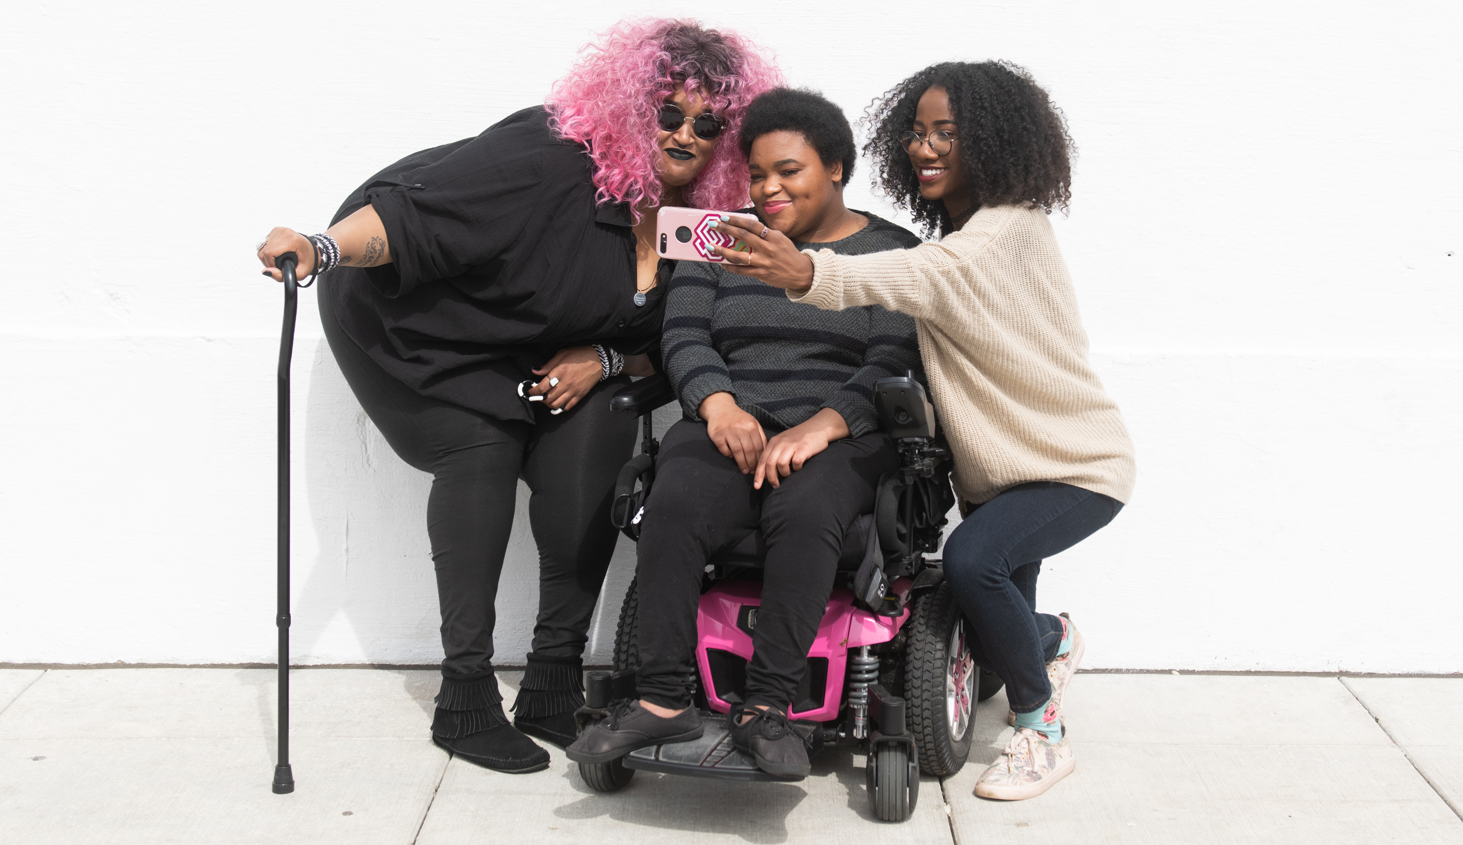
Why Disability Aware?
Notes:
In this section, we’ll cover some of our motivations for creating this training, other than the legal compliance we just covered. And we’ll also ask you to reflect on some of your own motivations.
Image: A zoomed out full body shot showing three Black and disabled friends (a non-binary person with a cane and tangle stim toy, a non-binary person sitting in a power wheelchair, and an invisibly disabled femme) smiling and taking a cell phone selfie together. Source: Disabled And Here. Photo by Chona Kasinger.

Slide 13
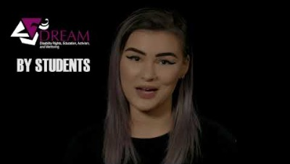
Student Perspectives (the “why” of our work)
Source: Youtube @ National Center for College Students With Disabilities
Notes:
If you remember, the opening image of this training was a person holding a sign with a common slogan from the disability rights movement that reads “Nothing About Us Without Us.” At DSPS, we often describe student perspectives as the “why” of our work and want to show you a video where students with disabilities share what it’s like to navigate higher education. Tech: Play video from start til 0:55 (https://www.youtube.com/watch?v=R-mq-24A66A) After video: What we consistently learn from disabled students in higher education is that there are common experiences of isolation, of underrepresentation, of exclusion, frustration, discrimination, shame, and more. The Disability Aware Project aims to alleviate and remove as many of those barriers as possible so that we as employees of higher education institutions take on the responsibility of ensuring ALL of our students, including those with disabilities, feel included, connected, and supported – not just because it’s their legal right to receive accommodations, but because our increased awareness and mindful actions have the power to enhance our students’ well-being, opportunities, relationships, and their overall success and quality of life in school, at work, and all aspects of life. When we focus-grouped this training with some of our own DSPS students, one common piece of feedback was “This should be mandatory.” We think that cuts right to the heart of the challenges so many students with disabilities are experiencing, and puts the ball in our court, so to speak, to help transform that experience.

Slide 14
More Meaningful Motivators
Eliminating Employment Disparities
Disabled people are 3 times less likely to be employed, more likely to work fewer hours, earn lower incomes, and accumulate less wealth than their counterparts without at least one disability. (Center for American Progress)
Protecting Mental Health/Safety
Disabled adults report experiencing mental distress 5 times more than those without disabilities. (CDC)
Understanding that Disability Inclusion Benefits Everyone
Awareness and action around disability enhances the overall experience for all.
Notes:
So, we know we have an obligation to comply with the law around disability. And we know we have a responsibility to center the perspectives of our students with disabilities. Those are two huge reasons to engage in this work, and there are many more motivators to consider - here are a just a few:
1) Eliminating Employment Disparities
2) Protecting Mental Health & Safety
3) Understanding that Disability Inclusion Benefits Everyone (give examples: curb cutouts, video captions) – ALSO, considering the likelihood that many of us who are not disabled may reach a point where we eventually do acquire a disability.

Slide 15
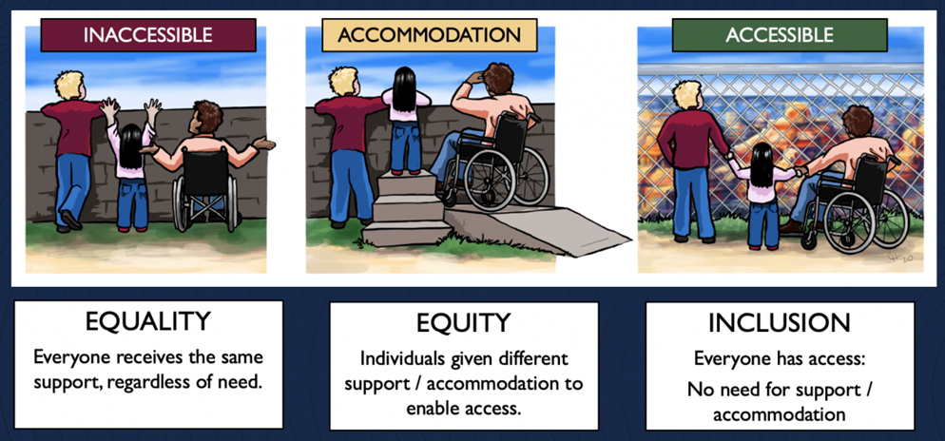

Design with All Students in Mind
Equality: Everyone receives same support, regardless of need. (Which can lead to inaccessible experiences and environments for some).
Equity: Individuals are given different support and accommodation to enable access.
Inclusion: Everyone has access; there is no need for support / accommodation (thanks to universal design)
(Image by Cora Hays, 2020 – Source: University of Illinois in Chicago’s Accessibility Center – partially modified by SDCCD DSPS for training purposes)
Notes:
This illustration helps us understand some of the differences between equality, equity, and inclusion as it relates to the concept of Universal Design.
In the first image, the headline says "Inaccessible" and the illustration shows three people behind a wall trying to access the view beyond it. One person has a clear view, but two people can't see above the wall because it is built too high to accommodate their height and wheelchair use, respectively. So even though everyone is receiving equality in terms of this safety structure, the design can lead to inaccessible experiences and environments because it does not take into consideration various needs.
In the second image, the headline says “Accommodation,” and the illustration depicts various accommodations that have been made to help individuals access the view. The person who wasn’t tall enough to see over the barrier in the first illustration is now standing on some steps, and the person using the wheelchair now has access to a ramp. This creates a more equitable experience for all because it takes various peoples’ needs into account and creates accommodations for everyone. As educators, accommodations are an important approach when we notice that physical or digital learning environments are inaccessible or inequitable. We will talk about some simple strategies for this as we move forward in the training, but we should also always be thinking about this last image…
…the headline says “Accessible,” and the illustration shows that the design of the barrier has completely transformed from a solid wall into a chain-link fence. Now folks, regardless of height or ability, etc., have access to the view without a need for any specialized accommodations. This isn’t to say that accommodations aren’t necessary in our current institutions, because they are, but it begs the question - how might our interactions with disabled people and the disability experience itself be improved if our physical and digital spaces, our learning environments, our courses, etc., were designed with all types of people and abilities in mind?

Slide 16
More Topics Covered in Training
Disability Glossary: Ableism, Microagression, Impact > Intent, Implicit Bias,
Medical Model v. Social Model of Disability
Person First v. Identity First Language
How to Connect Students with DSPS
Role-Play Activities
More Disability Facts & Myths
Spoon Theory Exercise
Actionable Steps for Inclusive Practices for your Class, Department & Services
And SOOO MUCH MORE!
Notes:
Definition: Ableism is "the discrimination of and social prejudice against people with disabilities based on the belief that typical abilities are superior." (Access Living, 2019)
Ableism comes in many forms:
physical, mental, verbal, and/or emotional abuse
designing spaces, events, etc. without accessibility or compliance in mind
excluding or segregating folks with disabilities
discriminating against folks with disabilities in schools, work, etc.

Slide 17
Myth or Fact
Myth or Fact: Every SDCCD student with a disability is enrolled in DSPS services.
Notes:
Myth or Fact
Alright, let's clear up a common misconception.
Myth or Fact: Every SDCCD student with a disability is enrolled in DSPS services.
Myth: DSPS services are voluntary and in fact, only about 5% of SDCCD students are connected to DSPS services, which means the majority of students are not voluntarily registered in DSPS. (SDCCD DSPS Dashboard)
Several factors contribute to students not being connected to DSPS services, including lack of awareness about available services, unfamiliarity with qualification criteria, social stigma, fear of disclosure, etc.
Understanding these numbers is important for our support efforts.
In the 2021-2022 academic year, San Diego Mesa College had 24,443 students, with 1,249 in DSPS and 829 in EOPS. Recognizing these figures helps us guide students toward DSPS services effectively.
Now, let's transition to an important topic: Person First vs. Identity First Language.

Slide 18

“Not Special Needs”
Source: Coor Down
Notes:
Whew! Congrats! We made it through our disability glossary, and now it’s almost time for a well-earned break - but first we want to close this section out with a quick video:
Tech: Show full video (Backup link: https://www.youtube.com/watch?v=kNMJaXuFuWQ)

Slide 19

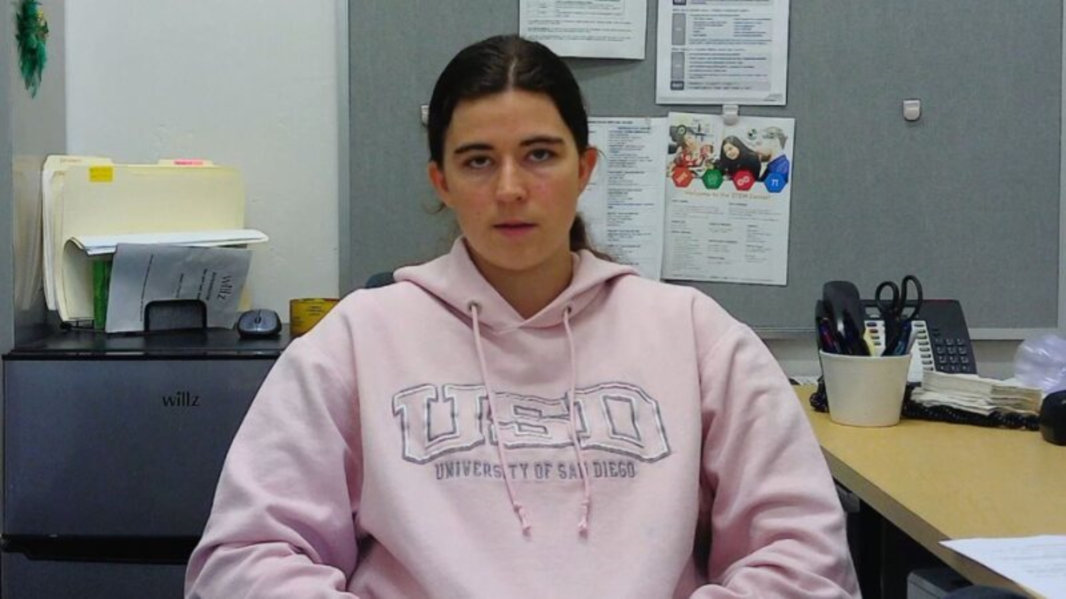
Mesa DSPS Students
Source: HTC San Diego Mesa College
Notes:
We’ve covered so much ground today - thank you for showing up with the kind of willingness to learn that we know will translate into improved learning environments and experiences across the District. We want to close by bringing it all back to our students, whom we’ve described as the “Why of our Work.” Here’s a video of our current Mesa DSPS students:
Tech: full video (backup link – San Diego Mesa College Testimonials Testimonals 3.mp4)

Slide 20
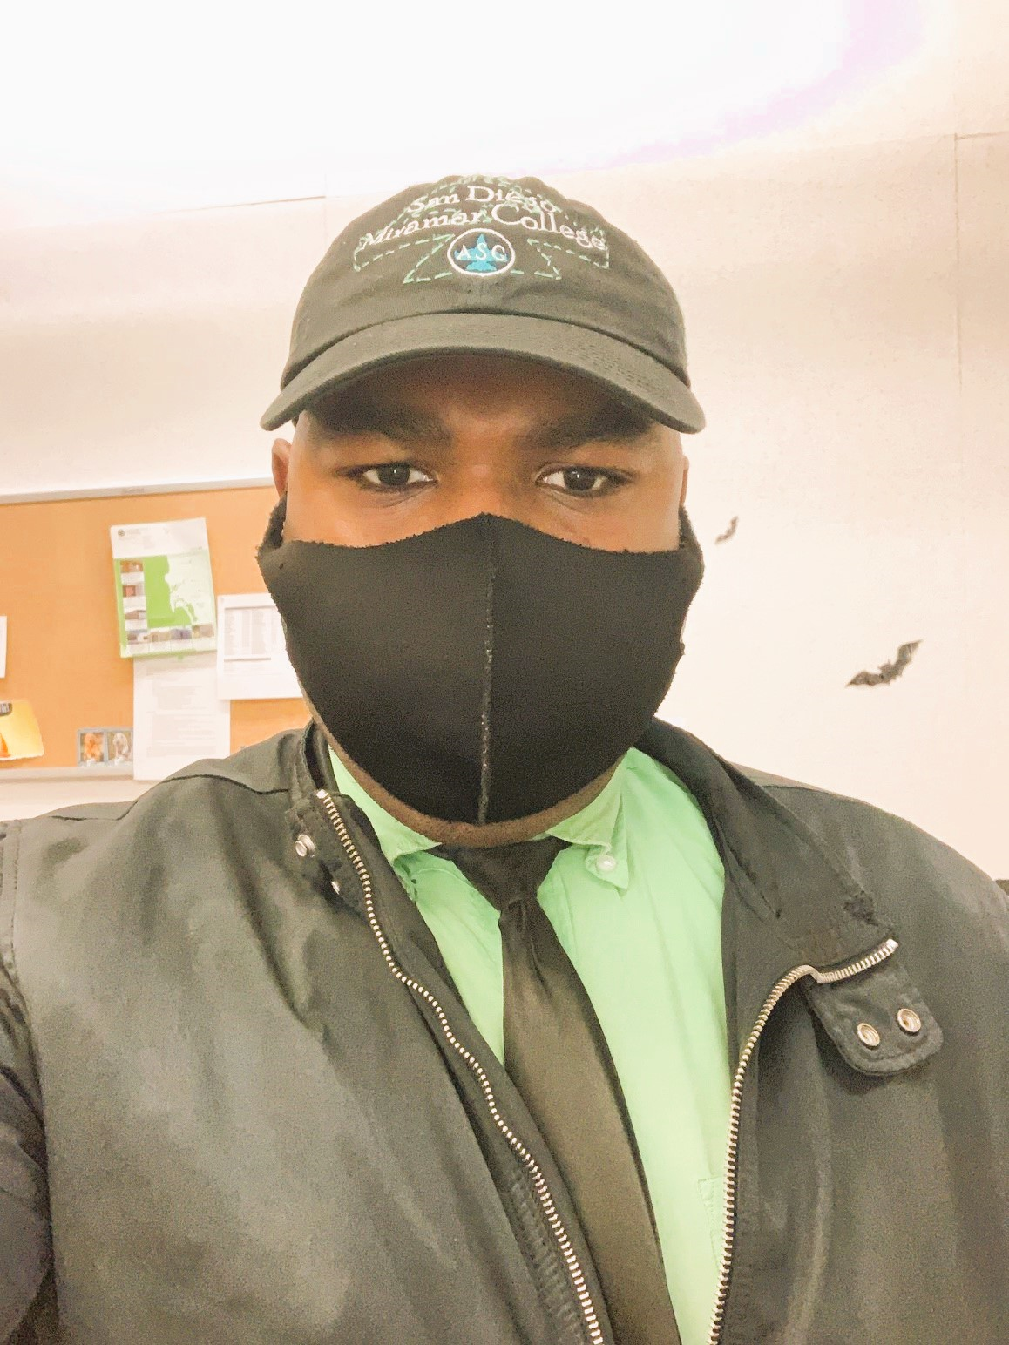
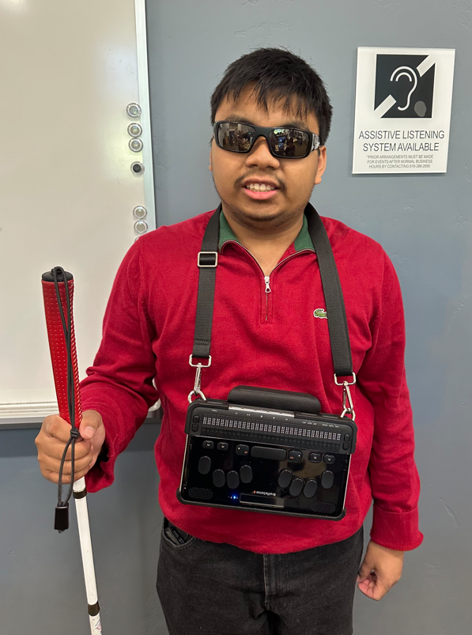
Student Spotlights (slide 1 of 2)
“Mesa has always been close to my heart, as it holds the same values I do. Making me feel closer to the community. Mesa DSPS helps me on campus with achieving my goals by helping me with my challenges, like test proctoring for my classes, which helps me prioritize my goals for the semester.” Kelvens Baptiste, Mesa College
"What I like about Mesa is how friendly and inclusive everyone is. I find I am always able to seek help, and it is a great place to be."?
Derrick Quiaot, Mesa College
Notes:
We’ll also share a few quotes from recent Student Spotlight interviews featuring current and former DSPS students
Facilitator can read quotes or ask for volunteers to read them (perhaps from students’ respective colleges)

Slide 21
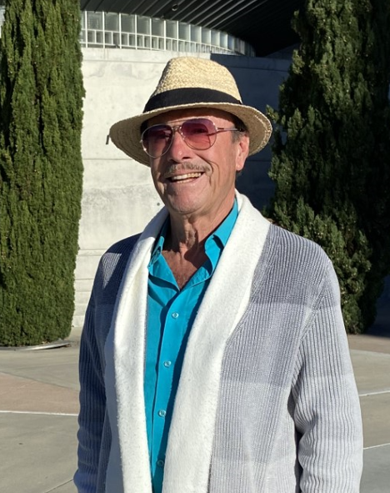
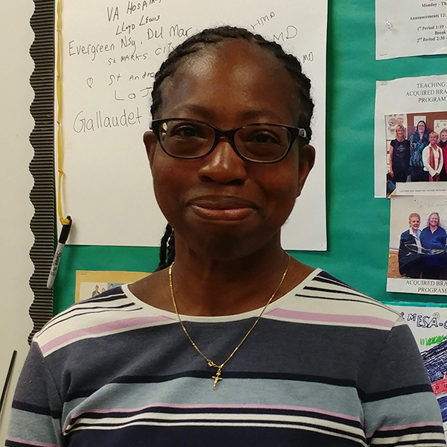
Student Spotlights (slide 2 of 2)
"I am truly grateful for the invaluable assistance provided by the DSPS High Tech Center; at my age, navigating technology was a daunting challenge, and without their support, completing assignments would have been impossible." Manuel Vargas, San Diego Mesa College
“Each class has been different, but what has been consistent is that all of them have taught me strategies to help me help my brain to accomplish daily tasks.” Mary Coleman, College of Continuing Education ABI Program
Notes:
Facilitator Notes:Facilitator can read final quotes or ask for volunteers to read them (perhaps from students’ respective colleges)
We’ll drop a link where you can find more Student Spotlights as well as a form to nominate any DSPS student to be featured:
Tech: Drop link in chat: https://www.sdccd.edu/about/departments-and-offices/student-services-department/dsps/happenings/student-spotlight.aspx

Slide 22
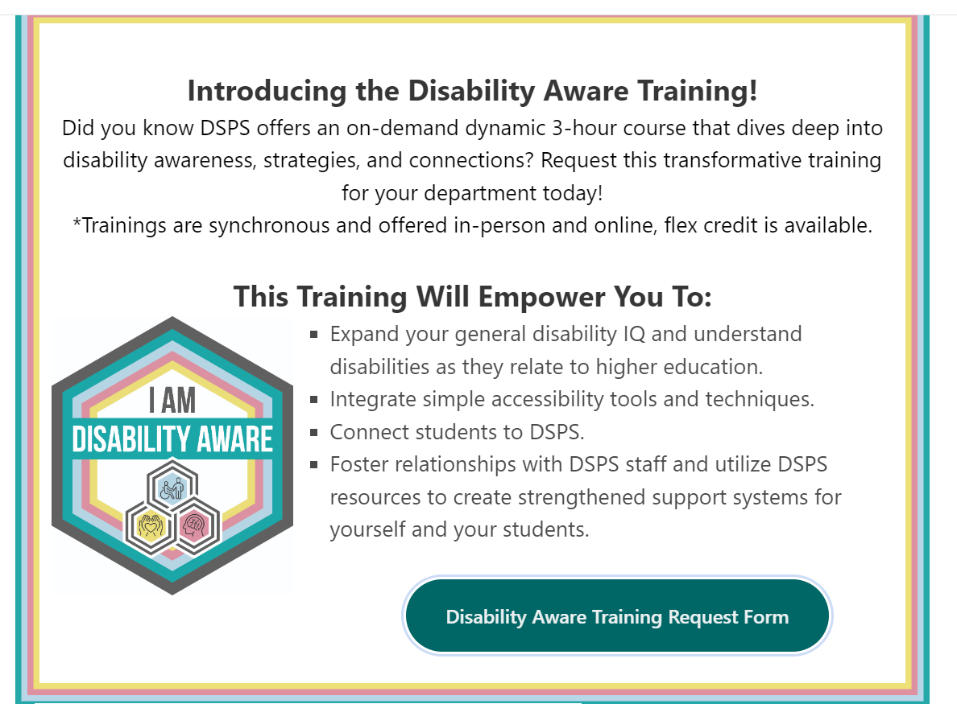
Questions & Next Steps!
Request the Full Disability Aware Training
Dept. Meeting
Summer Retreat
Flex Week
Notes:
Looks like there’s about [insert time] for questions - as we finish up, please remember to fill out the post event survey!
Tech: Drop link in chat - https://tinyurl.com/DisabilityAwareSurvey

