Slide 1


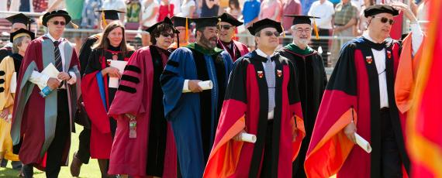
Requesting a Faculty Position
Preparing and submitting requests in Program Review

Slide 2

Agenda
Committee Purpose
Committee Membership
Rubric
Process Overview
Points to Consider
Completing the Request/Samples
Q & A

Slide 3
Purpose of Committee
Purpose
  The purpose of the Mesa College Faculty Hiring Priority Committee is to review and develop hiring priority recommendations for faculty positions that are submitted through the college-wide Program Review process.
Charge
  To develop an annual list of faculty hiring priority recommendations
  To review and update, as necessary, the faculty hiring priority criteria and evaluation rubric.

Slide 4

Membership of Committee
Faculty Representatives
  Academic Senate President – Co-chair
  5 faculty from Schools/Student Service Areas
Administrative Representatives
  Vice President of Instruction – Co-chair/Vice President of Student Services
  5 Deans from Schools/Student Service Areas
Notes:
Faculty/Deans represent all schools on campus without any one coming from same school.

Slide 5
Present Committee
Faculty
  Student Development
  Humanities
  LRAS
  Health Sciences
  Arts and Languages
Chairs
  AS President
  VPI
Deans
  Exercise Science
  Business and Technology
  Math and Physical Sciences
  Social & Behavioral Science
  Student Success and Equity

Slide 6

Process Overview
Program/service area identifies need for tenure –track faculty
Faculty position request form is completed
Requests reviewed and scored based on the established scoring rubric.
Prioritized list of faculty requests is developed
Prioritized list is sent forward to the PIE Committee for review
PIE approves and forwards the prioritized list to President’s Cabinet
The President’s Cabinet reviews and approves and sends recommendation to President
The President assesses needs and approves list with or without adjustment

Slide 7
Points to Consider
Separate position request for each position requested
Clearly detail differences and priority of each position
Need for new faculty positions must be identified and justified within Program Review.
Final decision rests with President
Effective requests require the use of qualitative and quantitative data.
Outcomes assessment data should be considered when drafting request

Slide 8
Request Form - Overview
Request Form
Criteria to Address
  Four Items
    Tenured/Tenure Track vs. Part-time Ratio percentage/Total FTEF/Efficiency
    Description of and Rationale for Position/Assignment
    Enhancement of Program/Service Area
    Other considerations
Notes:
Has your program or service area been approved to, or has it hired, any tenure-track faculty positions for fall 2017 or spring 2018?
If yes, indicate how many positions will be/have been hired and the position title(s)

Slide 9
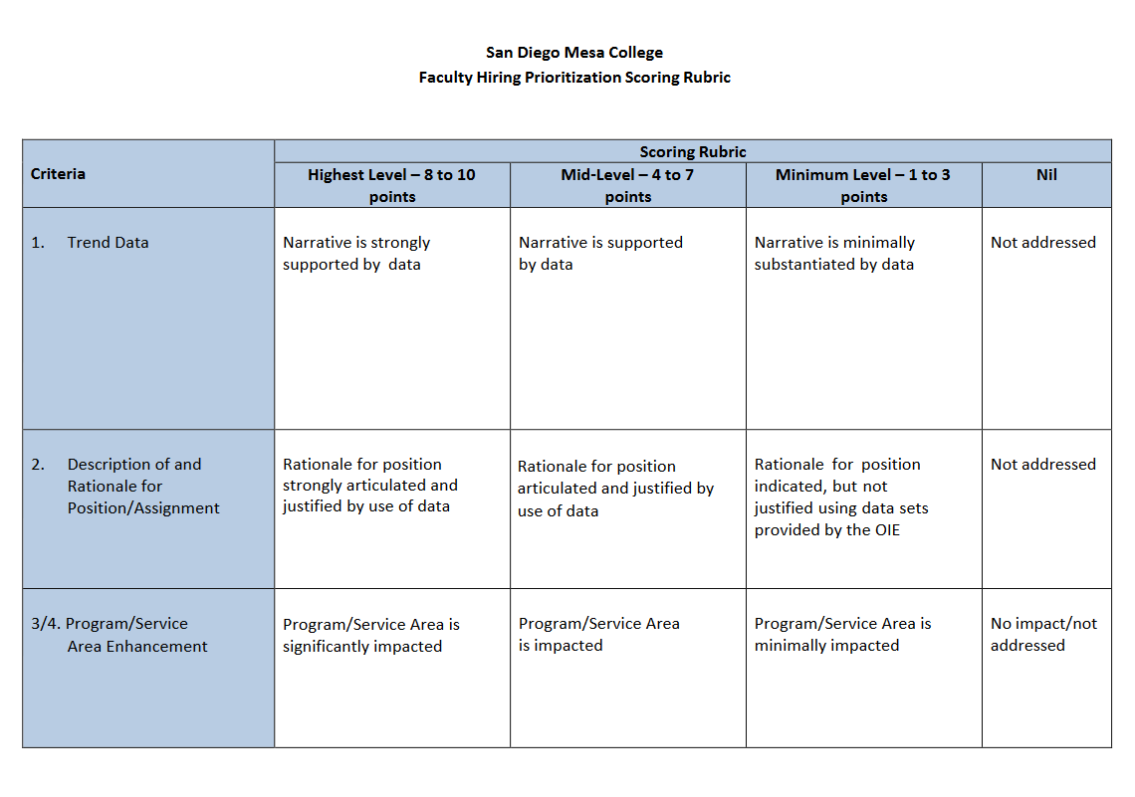
Rubric
San Diego Mesa College
Faculty Hiring Prioritization Scoring Rubric

Slide 10
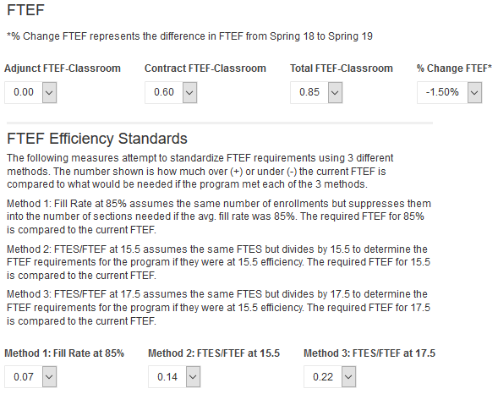
Data –
FTEF Ratio/Efficiency
Notes:
Many new tools this year for course and program data – Faculty Headcount, FTEF Ratios. Program Statistics – as of 9/12/17 and 5 – year history. Also has a breakdown of student demographics.

Slide 11
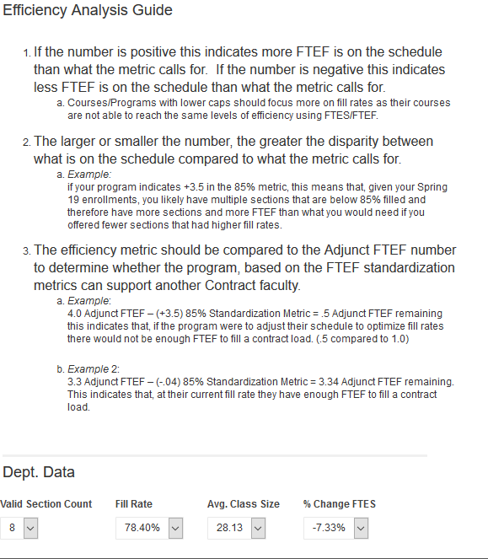
Data –
Efficiency Analysis/Department Data
Notes:
Many new tools this year for course and program data – Faculty Headcount, FTEF Ratios. Program Statistics – as of 9/12/17 and 5 – year history. Also has a breakdown of student demographics.

Slide 12
2. Description of and Rationale for Position/Assignment: Describe all aspects of the position, including non-teaching assignments, and the need for the position supported with relevant data as provided by the Office of Institutional Effectiveness (OIE). (750 word limit)
As referenced in the “Program Changes,” “Success and Retention,” and “Productivity” areas of the Tiddlywinks Program Review, there is a critical need for new tenure-track (TT)faculty for the Tiddlywinks discipline.
A new TT faculty member is needed to meet the demand of the increased number of class sections. This position will also serve as the Director of the program, which will meet the requirements of establishing an apprenticeship program in partnership with the Tiddlywinks Trade Union Local 3325(TTU)(Program Goal #1). The TT faculty member will work with the TTU and employers in the community to expand the program allowing Mesa to meet the needs of the Business Community in this area.
The new faculty member will teach classes, review and revise curriculum, prepare the program review, and serve as the chair of the Tiddlywinks Advisory Committee in addition to other departmental and college duties.
In Addition, the most recent outcomes assessment it was determined that students were not handling yellow tiddlywinks at the desired level. As our current faculty are at workload capacity, a new faculty position would allow the department to adjust the curriculum to address the yellow tiddlywink deficiency.
The addition of this new TT faculty will allow the Tiddlywinks Program to meet the needs of students and the community through establishing a new apprenticeship program that will provide students with employment or preparation for further education in the field upon graduation.

Slide 13
2. Description of and Rationale for Position/Assignment: Describe all aspects of the position, including non-teaching assignments, and the need for the position supported with relevant data as provided by the Office of Institutional Effectiveness. (750 word limit)
The Tiddlywinks program currently offers 82 class sections, with adjunct faculty teaching 75% of these sections. As seen in the data provided, the trend towards an increasing number of students enrolling in Tiddlywinks classes is apparent. It has increased from 77% efficiency in spring 2007, to 93% in spring 2013. This is likely due to the demand in the industry as indicated in the college’s recent environmental scan.
As indicated, there is ratio of about 78% adjunct to 22% full-time faculty for spring 2013. Previous years reflect similar ratios, with the full-time faculty percentage never exceeding 30%. A new faculty position will reduce this excessive reliance on adjuncts. The program values its highly qualified adjunct, but requires full-time faculty to meet with and mentor students, to perform duties within the disciplines and to perform duties within the campus community, such as those mentioned in the previous section of this request.
The majority of Tiddlywinks class sections are taught by adjuncts, many of whom cannot spend time on campus to helping students. It is crucial to have tenure-track faculty present to ensure quality education as well as heighten the sense that this is a community within which instructors work and learn. Many adjuncts, because of limited opportunities at Mesa, have sought full-time positions at other colleges and have been hired or have found jobs within the industry. Thus, the department is constantly in a position of having to find, hire, and evaluate new adjunct faculty, which is a time consuming task for the few tenured faculty in the program.
Notes:
Three different answers to the same question. What are the strengths and weaknesses of each answer?

Slide 14
2. Description of and Rationale for Position/Assignment: Describe all aspects of the position, including non-teaching assignments, and the need for the position supported with relevant data as provided by the Office of Institutional Effectiveness. (750 word limit) (Counseling)
There continues to be a lack of sufficient counseling faculty to assist with the continued demands of the SSSP Plan. This is apparent through the average drop-in sign-in displaying 112 students during peak registration times, and the data for counseling student head count. Comparison of 2013-2014 to 2014-2015 show an increase across the board in the demand for counseling appointments (up by 2,083), drop-ins (up by 6,580), workshops (up by 317). Total number of students served by the counseling office increased by 8,980 in 2014-2015.
The mission of SSSP is "To increase community college student access and success by providing effective core services, including orientation, assessment and placement, counseling, academic advising, and early intervention. SSSP ensures student equity in assessment, student services, and access to college resources and provides a foundation for students to achieve their educational goals.
SSSP includes increasing the number of matriculated students (those who completed the three core services of assessment, orientation, and education planning). It is crucial that these core services are provided to students upon entry, and ensuring that they receive services along the pathway to completion. One way to promote this is through the scaling up of the First Year Experience Program, and developing a Second Year Experience Program aimed at increasing persistence rates. In order to do this, faculty are needed to help teach Personal Growth, coordinate the SYE Program, and work with students in the program. This responsibility cannot be handled by one person alone. In addition to a dedicated FYE coordinator, faculty are needed to work with students to help track their progress, provide the necessary resources to promote success. Additional counseling faculty positions are needed to help ensure that students receive the assistance needed in order to identify a course of study and develop a student education plan reflective of their desired goals. Inside Higher Education refers to the second year as "The Lost Year". Higher education tends to place a lot of emphasis on first year programs, but of crucial importance is the second year, because unfortunately, this is the time when it's easy for students to get lost. Support is provided and mandated as part of the first year experience at Mesa, but after the students' first two semesters, there isn't much tracking done.
In addition, there is a high demand for “embedded Counselors within several grants and initiatives across the campus. The Basic Skills Student Outcomes Transformation Grant calls for 3.0 FTEF for counselors to be available for students in identified basic skills courses. The present demand within the counseling center does not allow for the requested hours in the grant. Embedded counselors are also included in two other grants for which the Counseling Department is unable to meet the demand without adding more tenure-track counselors.
Notes:
Two different answers to the same question. What are the strengths and weaknesses of each answer?

Slide 15
3. How will the addition of new tenure track faculty enhance your program/service area? (500 word limit)
The Tiddlywinks program has steadily improved student success, retention and overall GPA over the past five years. This holds true for student populations across gender and for all ethnicities. The retention rates for all students in the program have increased from 83% to 88% in the fall semester since 2008. Similarly, the rates have gone from 84% to 89 percent through Spring ‘13. Success rates have also improved from 69% in Fall 2008 to 74% in fall 2012 and from 68% to 72% during the spring semesters through 2013. GPAs of the students in the Tiddlywinks program have also improved from 2.55 in fall 2008 to 2.74 in fall 2012 and from 2.65 to 2.75 during the spring semesters through 2013. The patterns are similar in all areas for students in all ethnicities.
The increased retention and success rates and the improvement of student learning outcomes coupled with the high efficiency rates discussed in the previous question indicate growth and increased demand for the Tiddlywinks program. With the opportunity to serve even more students with a career path through the apprenticeship program , it is imperative that more full-time faculty be hired to ensure the quality of the curriculum.
An additional faculty well allow us to make adjustments to curricula to enhance student learning based on outcomes assessment.
Notes:
This is

Slide 16
4. Other considerations/data that support your recommendation not covered in questions 1-3. (250 word limit)
As noted in the previous item in this request, the field of Tiddlywinks is expected to grow by 60% over the next five years with much of that growth happening ion our area. San Diego Mesa is the only public institution to offer a Tiddlywinks program in Southern California, making it an accessible career for all prospective students, and much of the industry is located in our community. The expansion over the next five years in the industry translates to 2500 new jobs with that number expected to continue to grow over the next two decades. Hiring at least one new TT faculty will allow San Diego Mesa College to be the major contributor to supplying highly trained professionals to meet that growth.
Tiddlywinks Industry Environmental Scan URL – www.Tiddlywinksisgonnabebig.gov

Slide 17

Thank You & Questions
Faculty Hiring Prioritization Committee

