Slide 1

Classified Position Requests
Submitting requests as part of the Program Review process
Presented by Classified Hiring Priorities (CHP) Committee
November 4, 2019

Slide 2
Today’s Agenda
Process Overview
Points to Consider
Accessing Request in Taskstream & Portal
Completing the Request Form in Portal
Scoring Rubric
Q & A

Slide 3
PROCESS OVERVIEW
The department identifies the need for classified staff as part of the Program Review process. (through 2/3/20)
Writer completes the Classified Position Request Form through Portal. (through 2/3/20)
CHP reviews/scores the requests based on the scoring rubric and develops a prioritized list of request. (February through April)
CHP presents the prioritized list to Classified Senate to ensure the process is followed and the Senate is informed. (April)
CHP forwards the prioritized list to Planning and Institutional Effectiveness (PIE) for review. (April)
The prioritized list is presented at the President’s Cabinet for review and approval. (April)

Slide 4
POINTS TO CONSIDER
Only one position request per form.
This process cannot be used for position reclassification.
This process can be used to increase positions.
(e.g.; .50 FTE to 1.0 FTE or a 10 month to a 12 month.)
Positions that are approved and funded on campus must follow the District approval process.
Administration may also fill vacated positions as necessary.
Shared position requests are first reviewed/scored individually and then combined for a final average.
Utilize the scoring rubric to help guide the depth of information that you will provide in your responses.

Slide 5


Where to find the form
Access to Taskstream
https://login.taskstream.com/signon/
Click on the 2019/2020 Program Review for your area:
(the example below is from Administrative Services)
3. On the left-hand side menu bar, click on “Classified Position, BARC and Faculty Position Request”

Slide 6

Where to find the form (Continued)
Click “Requests Form Portal” under Web Links and review scoring rubric under File Attachments
Request Form Portal
Scoring Rubric
or
Notes:
Above links are outside of Taskstream.
Review scoring rubric to help guide the depth of information that you will provide in your responses.

Slide 7
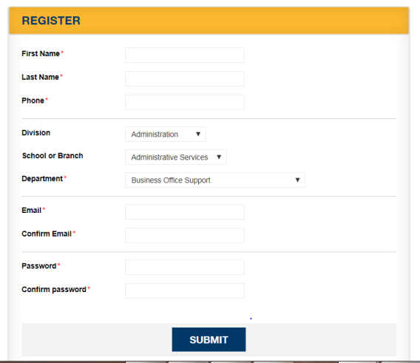
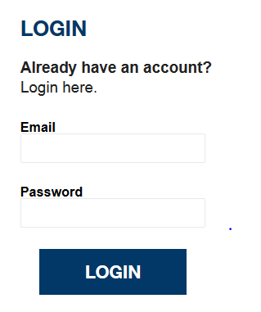
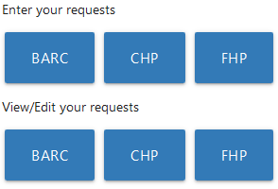
How to access to portal
5. Register to create login to access to the Portal
6. Login to the Portal
7. Click “CHP” under Enter request

Slide 8
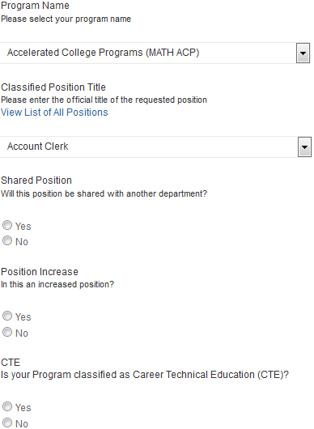
Enter request
8. Enter CHP Request
Select your program name from pull-down menu
Official Classified Position is available at:
http://hr.sdccd.edu/classification/offtech.cfm
If the position that you want does not currently exist in the classification descriptions, choose position that most closely relates to what you are looking for.
Notes:
Knowing if a program is CTE helps in two ways:
Possible funding source (non-general fund)
Identifies the needs of CTE programs in context to the overall campus needs.

Slide 9
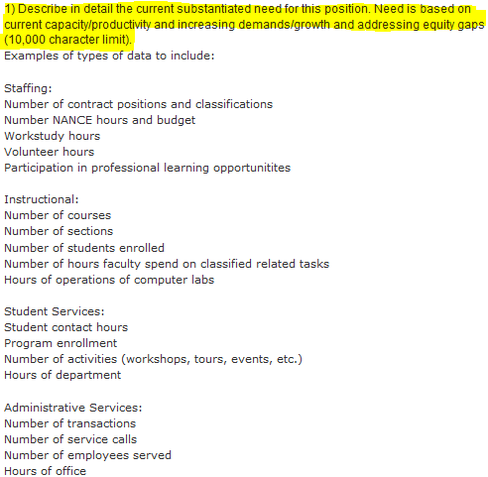
Enter request (Continued)
Answer Question 1
Utilize rubric to answer:
Use of data in response
Articulate why the position is needed and relate it to data
Current capacity (volume: how much) & Productivity (speed: how fast)
Demands / Growth Address Equity
10,000 character limit (1300 words)
Notes:
Example:

Slide 10

Enter request (Continued)
10. Answer Question 2
Impact on Outcomes
References:
Mission/Vision/Values: | http://bit.ly/SDMESA_MISSION
Strategic Directions and Goals: | http://bit.ly/SDMESA_SDG
3000 character limit ( words)
Notes:
Example:

Slide 11
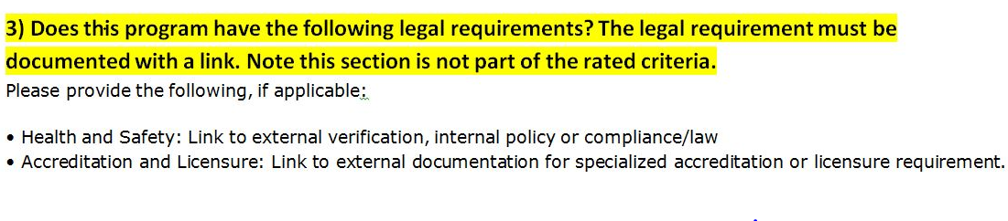
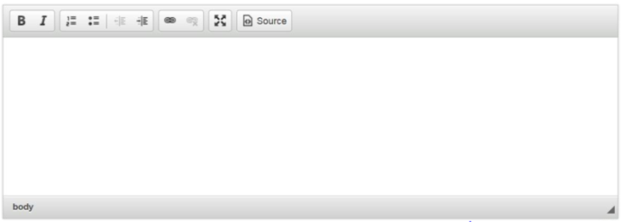
Enter request (Continued)
11. Answer Question 3
This question is not part of scoring
Answer Yes or No
If Yes, explain and provide a link
Notes:
Example:

Slide 12
Scoring
Review Criteria and Scoring Rubric for guidance on levels of response.
Responses are judged by their thoroughness in addressing the five criteria in the rubric
There are 25 maximum points for the overall request (5 maximum points per each criterion)
Response Level | Example
Highest Level (5 points) | Specific rationale are articulated and clearly linked details are supported by data.
Mid –Level (3 points) | Data provided but not analyzed and/or not linked to rationale.
Minimum Level (1 point) | Passionately written but does not provide rationale or data.
Not Addressed (0 points) | No response or only refers to “see program review”.

Slide 13
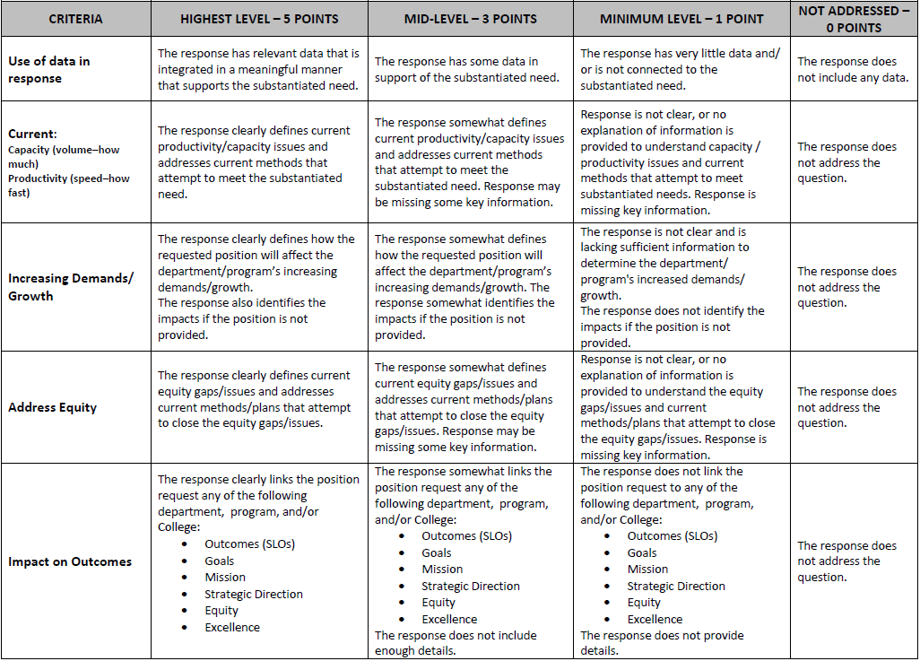
Rubric

Slide 14
Thank you & Questions
CHP Website: http://bit.ly/SDMESA_CHP
Classified Hiring Priority Committee
Contact the Chair with Questions
Ellen Engels eengels@sdccd.edu x2746
Andrea Lelham | Marco Chavez
Ellen Engels | Monica Romero
Joe Benedito | Alexi Balaguer
Karla Trutna | Gity Nematollahi
Lorenze Legaspi

