Slide 1
Fun With Data
Dr. Bridget Herrin
Associate Dean, Research & Planning

Slide 2
Scorecard Snapshot
Mesa Dashboard
Student Success Scorecard
CCCCO DataMart

Slide 3
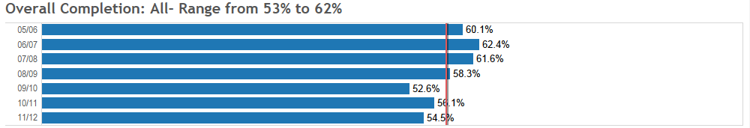
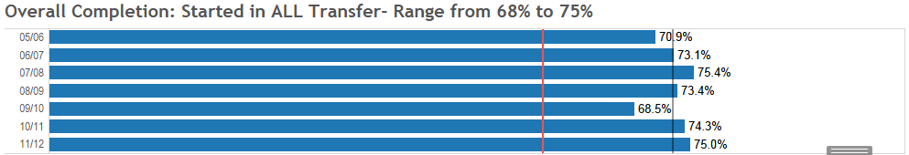
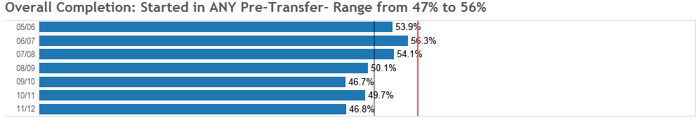
Completion
Overall (N= 17,628)
“Prepared” (N=5,577)
“Unprepared” (N = 12,051)

Slide 4
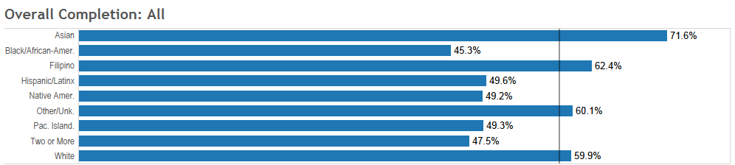
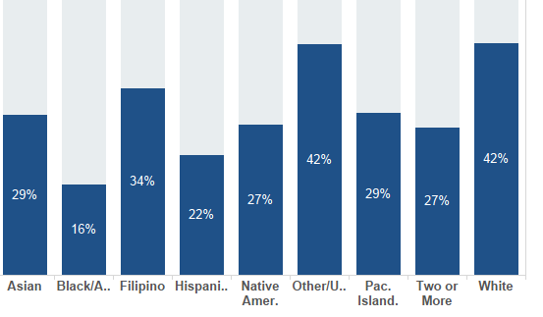
Completion by Race
Percent of Racial group who is identified as “Prepared”

Slide 5
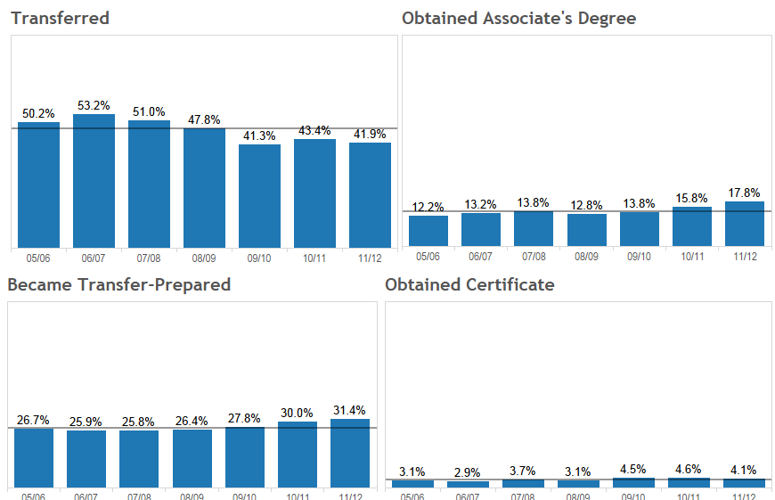
How are students Completing?

Slide 6
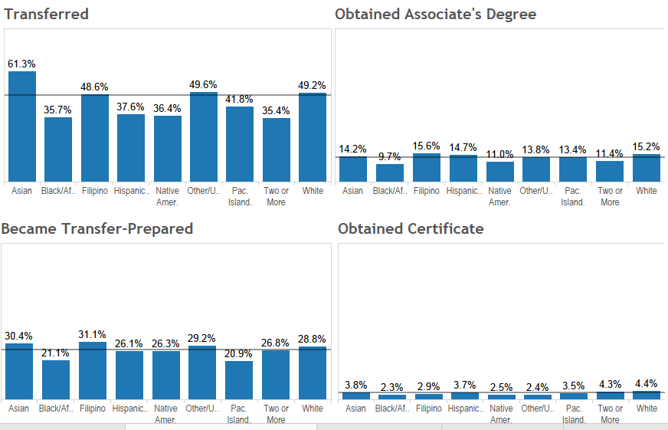
By Race?

Slide 7
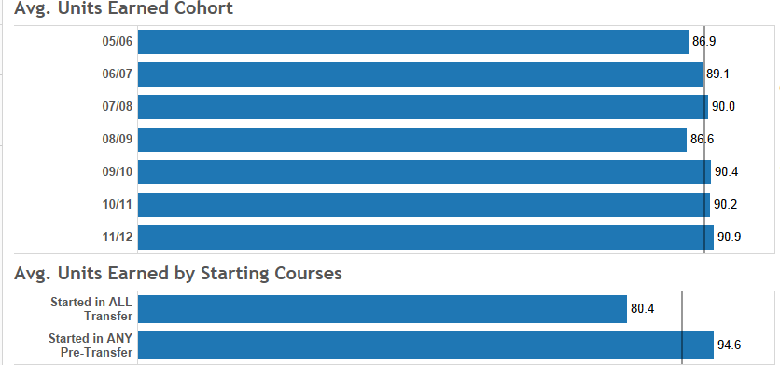
Avg. Units Earned
AA/AS Degree Completers

Slide 8
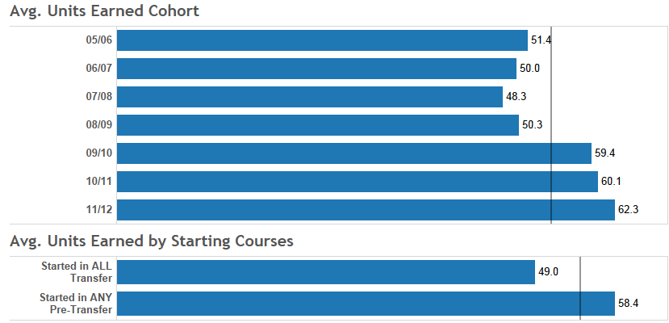
Avg. Units Earned
Transfers

Slide 9
Transfer Level Achievement- 1 Year
Scorecard Cohorts

Slide 10
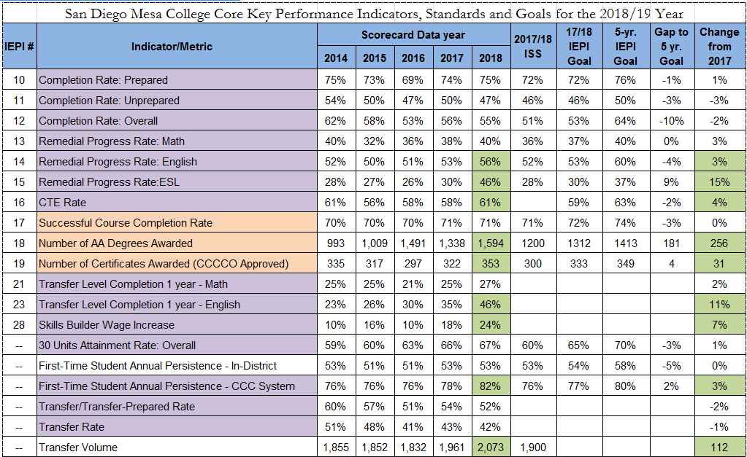
2018/18 IEPI Framework

Slide 11
Progress, Celebration, Reflection
Review of Institution Set Standards
Review of 2017/18 IEPI Goals
  Progress toward goals
    Which metrics are we doing well on?
    Which metrics are areas ripe for improvement?
  What have we done that is already making an impact? that we think will make an impact for future cohorts?
    Structural changes
    Cultural changes
    Initiatives
  Reflecting on areas where we haven’t met our goals, what is impacting these metrics? (focus on Institutional control)

Slide 12
Looking forward
IEPI Framework changes
Mesa Pathways
Equity Focus
Employment/Workforce metrics

Slide 13
Guided Pathways Launchboard
Strong Workforce Launchboard

Slide 14
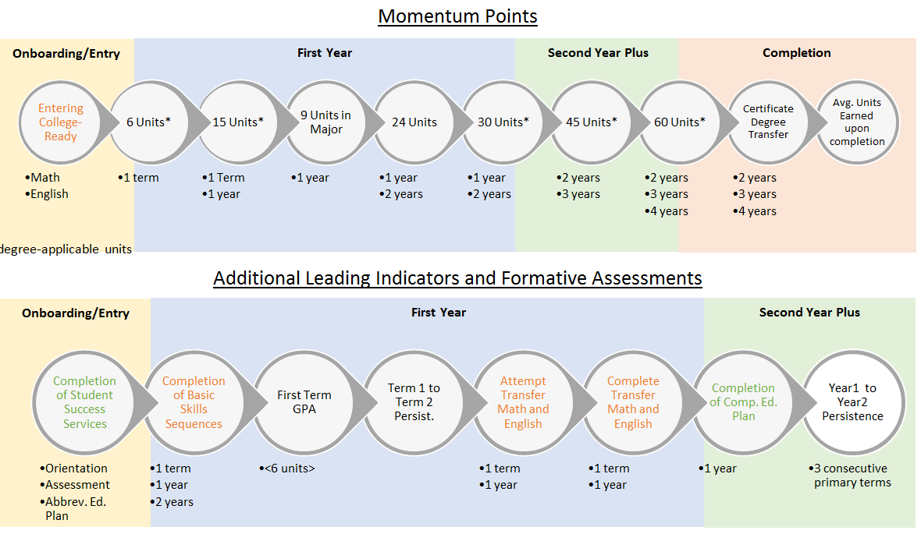
Key Performance Indicator Framework

Slide 15
Focus on First year and clear paths
Equity
  50-60% of equity gaps in completion is explained by placement (Stoup, 2016)
  15-25% of equity gap is explained by course taking patterns
  15-25% by Academic performance
Momentum
  31% of the variance in units earned by year 6 is explained by the units earned in the first term (Herrin, 2016)
  Only 8% of students who earned less than 12 units in their first year reached the 60 units milestone
  Compared to 51% of those who did earn 12 units

Slide 16
Goal setting and evaluation
Establishing Standards and goals
  What do we need to know to establish goals?
  Where do we start-backwards design?
Connecting goals to practice
  How do we know what works (and what does “work” mean anyway)?
    Before we try
    Once we’ve started
  What do we do with evaluative information once we have it?
    How does it inform practice

Slide 17
Proposed Framework
Identify 5-6 metrics you’d like to focus on (at least 2 from the list below)
Review the trends in data
Identify a standard, 1 yr. goal, and 5 yr. goal for each
Goals should consider Equity
ACCJC Required:
  Course Completion
  Degrees awarded
  Certificates awarded
  Transfer volume
  Licensure Pass rate (CTE)
  Employment (CTE)

Slide 18
Questions, Reflections, Comments

