Slide 1
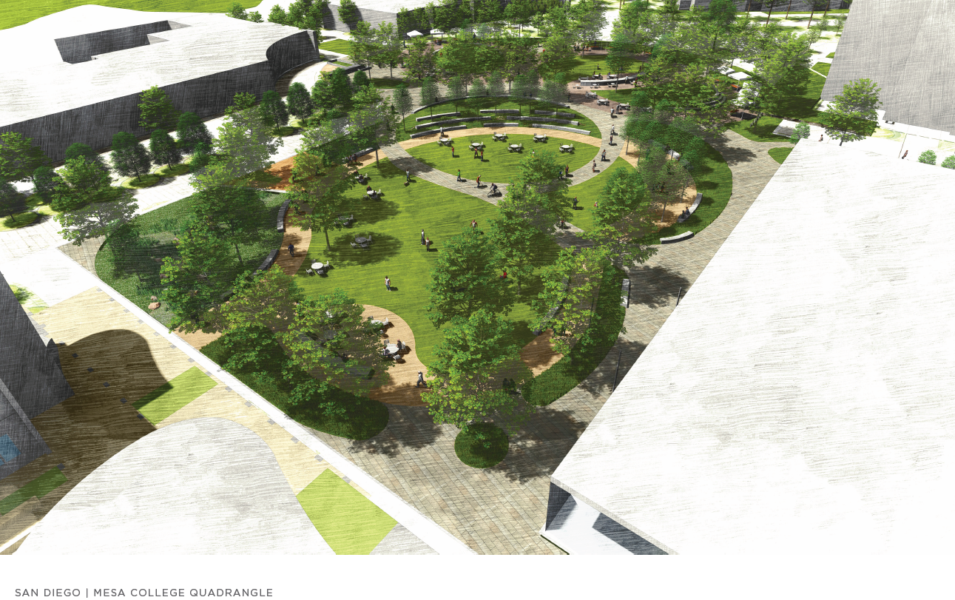
Facilities Update

Slide 2
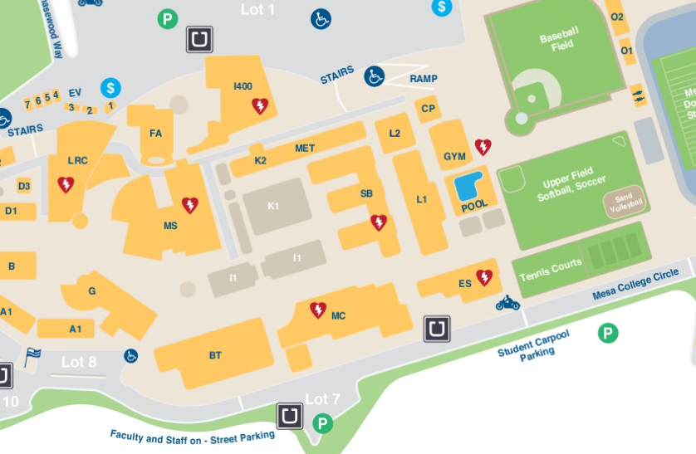
Facilities Update Cont’d

Slide 3
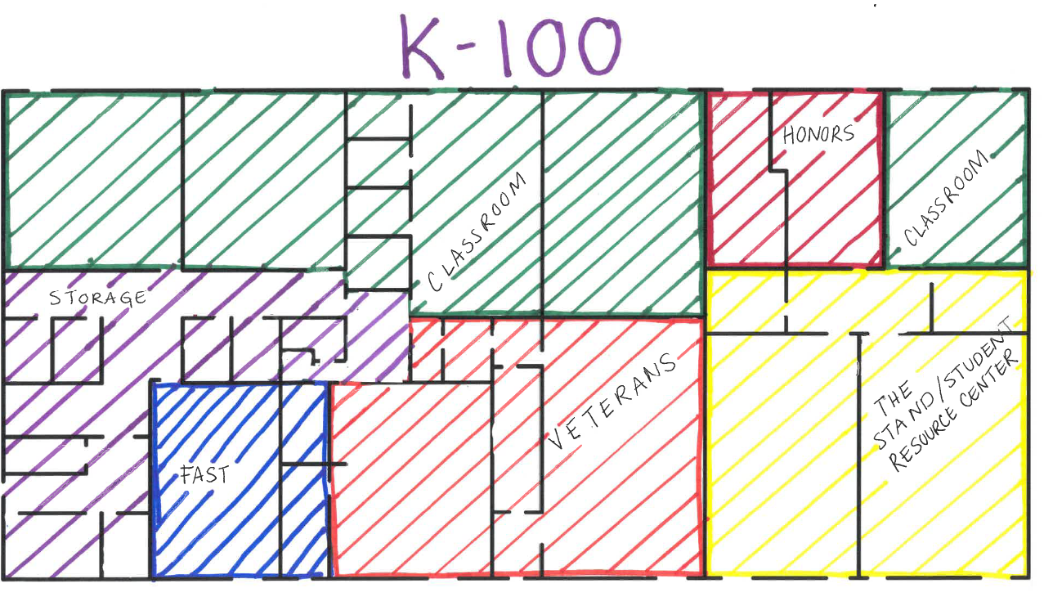
Facilities Update Cont’d
K Building Occupants:
FAST
Veterans
Honors
The Stand: Resource Center
English Classrooms

